Slide 1


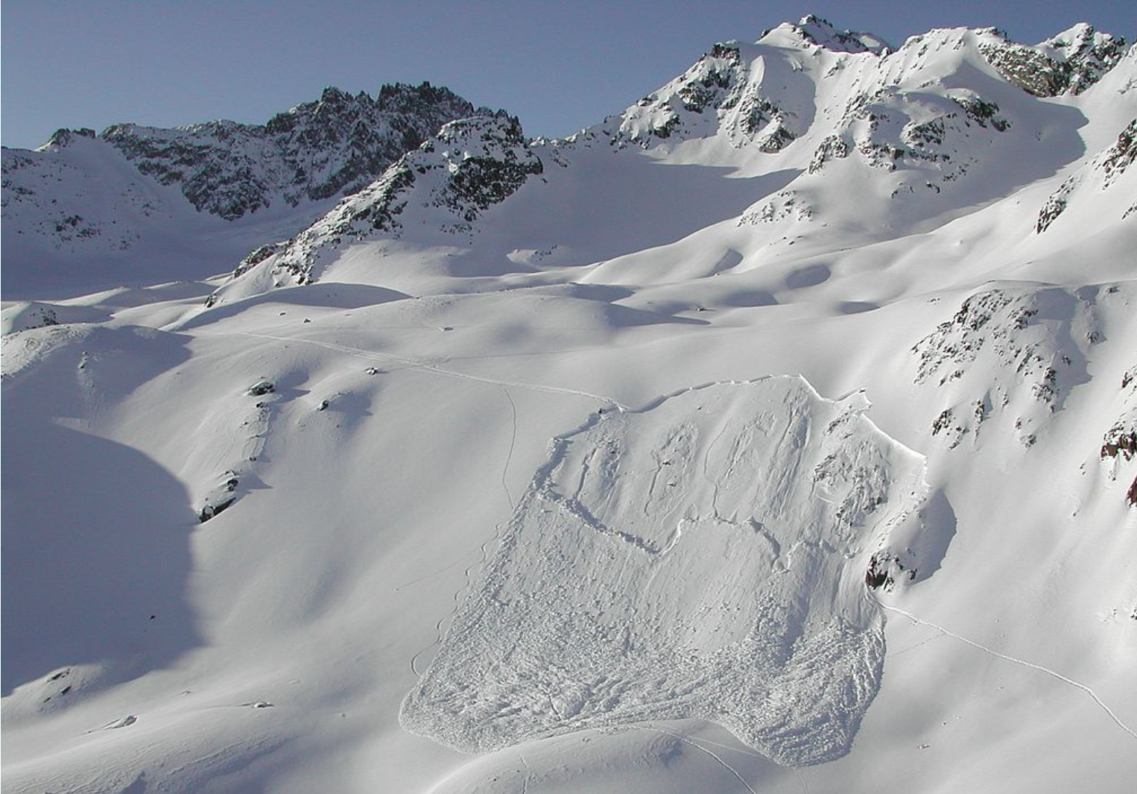
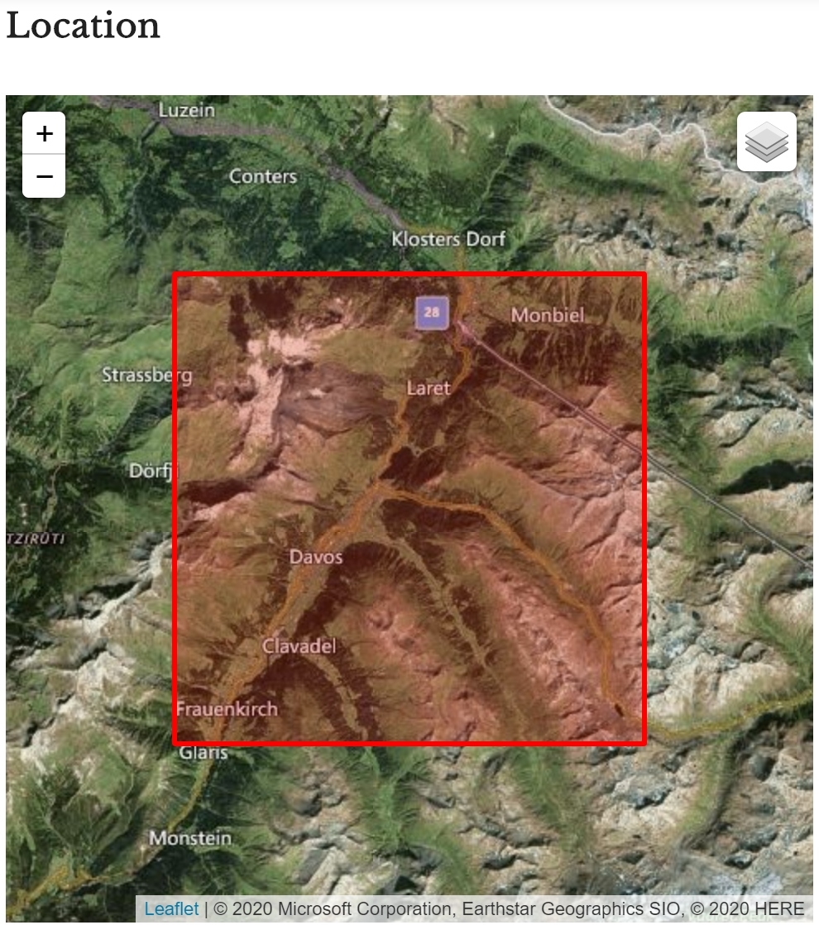
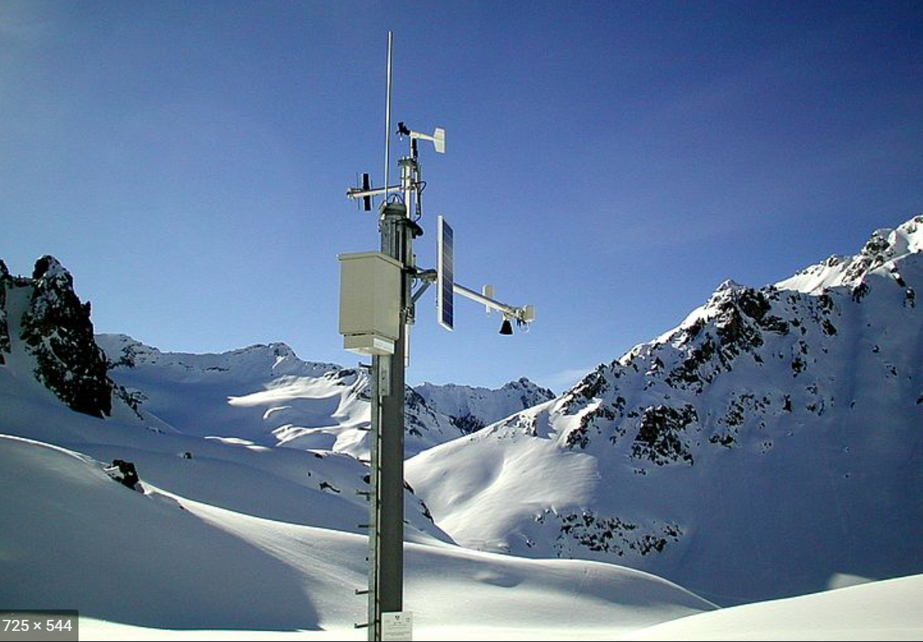
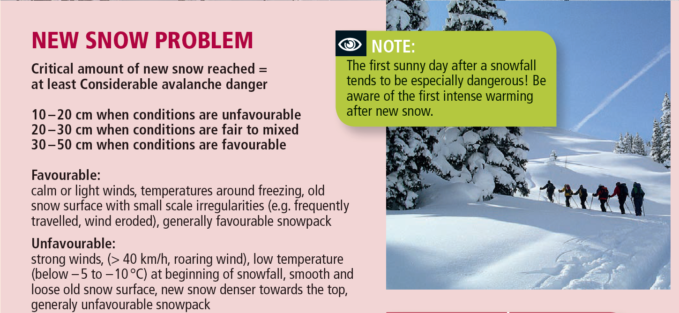
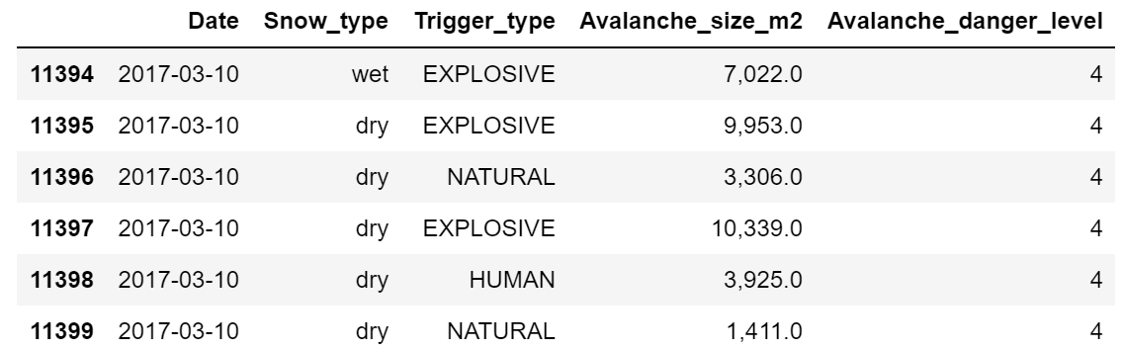
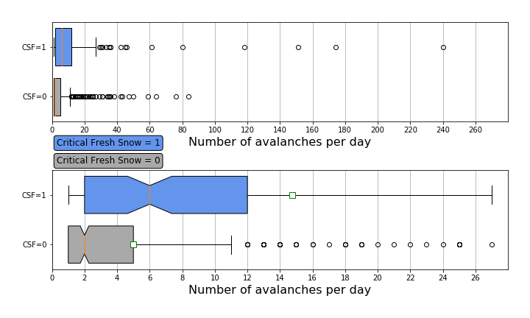
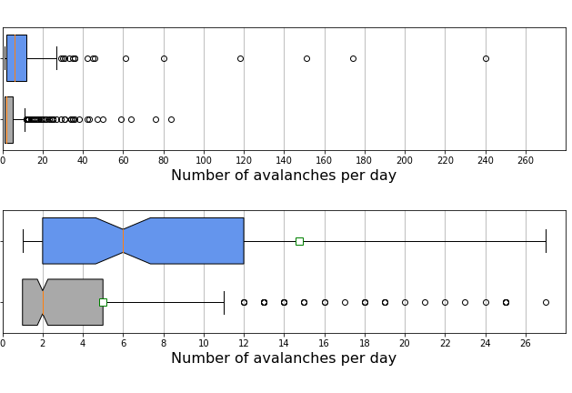
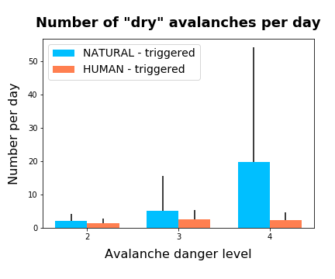
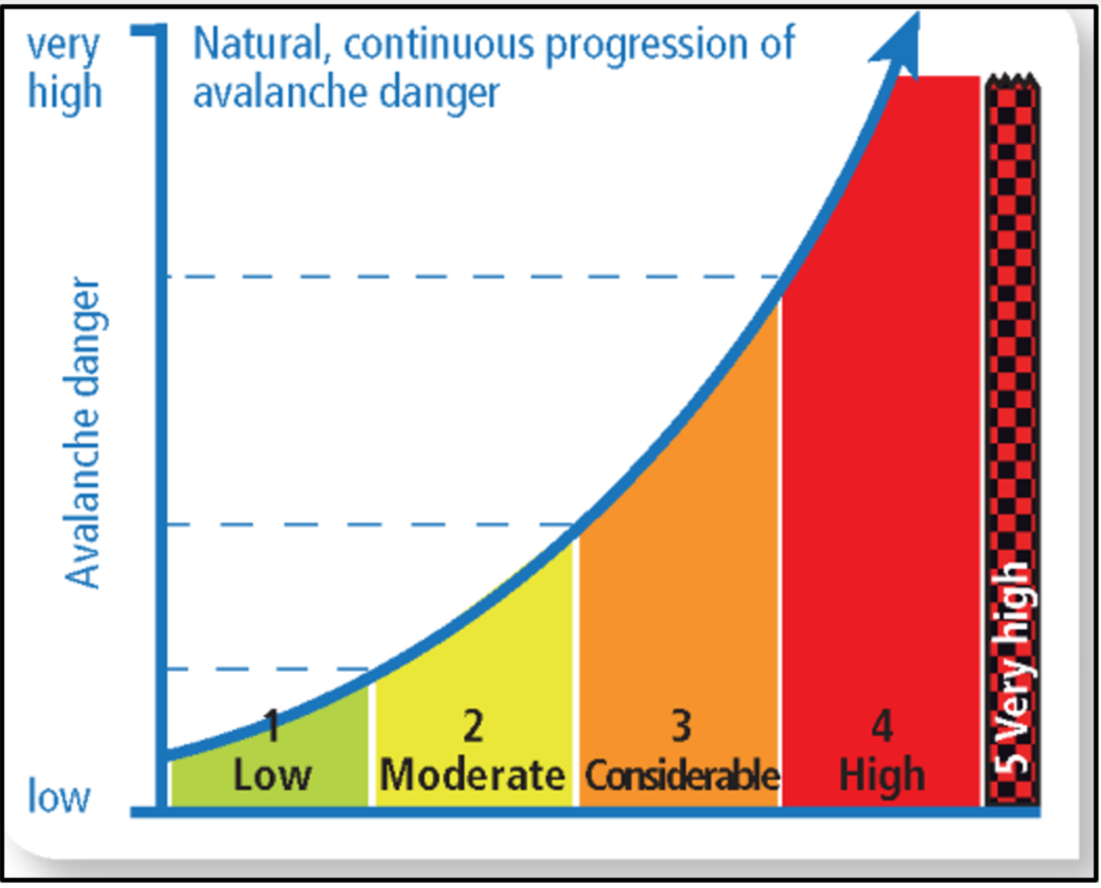
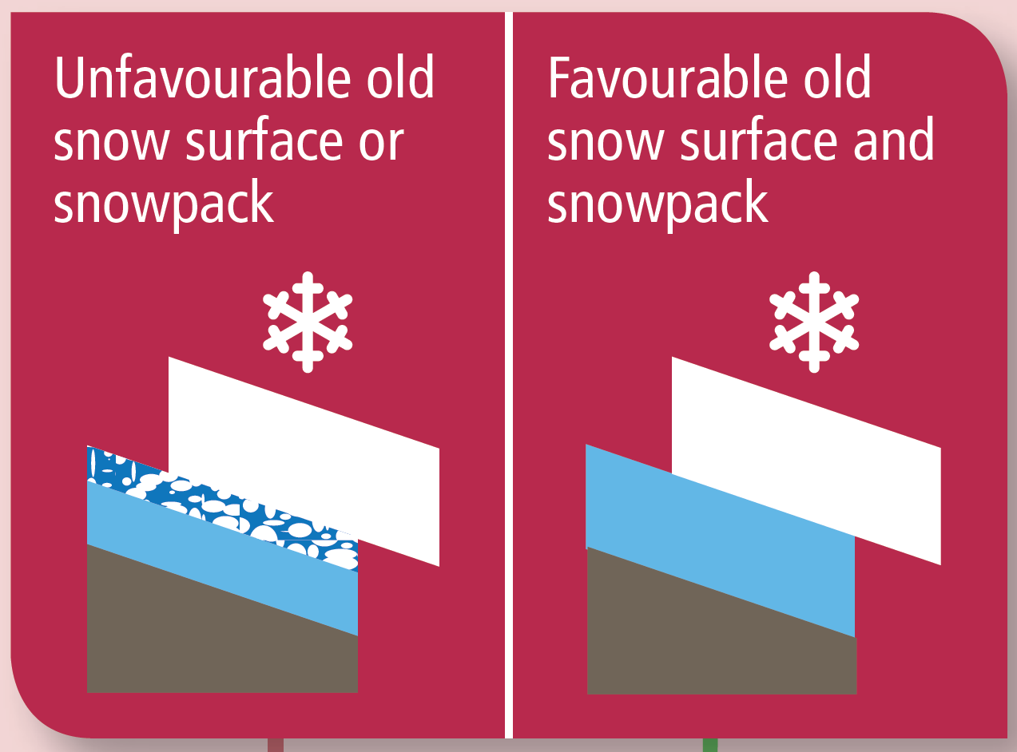
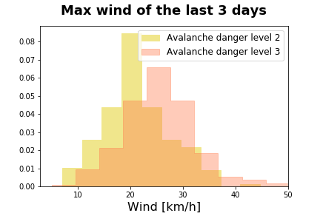
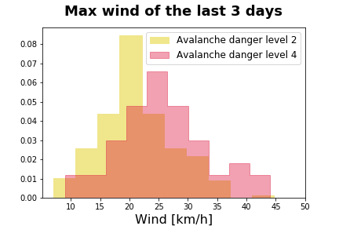
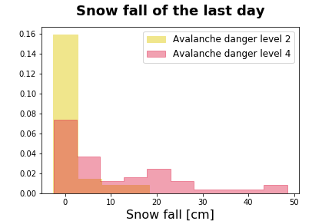
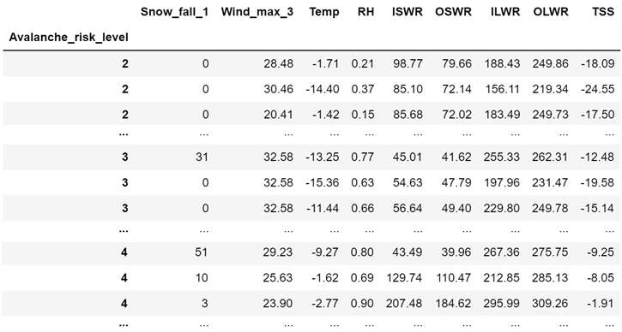
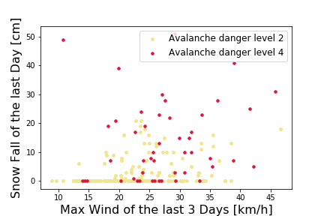
CAS Applied Data Science – Module 2 Project – Lionel Perret – 16.10.2020
Prediction of Avalanche Danger Levels
with Meteorological Data
Overview and Concept
DATA SET 1
13’918 Recorded
Snow Avalanches
1999-2019
Module 3 – Project
Prediction of
Avalanche Danger Levels
with Meteorological Parameters
Data Combination
and
Analysis
Critical Fresh Snow = 1
10 to 25 cm Snow fall with “Unfavorable conditions”
Wind max > 40km/h OR Temp min < -7.5 degree C
OR
More than 25cm Snow fall
Module 2 – Project
Investigate the Influence of Meteorological Parameters on the Number of Avalanches
Davos
~ 17km
Criteria used
to split data into 2 classes
Critical Fresh Snow = 0
10 to 25 cm Snow fall with “favorable conditions”
Wind max < 40km/h AND Temp min > -7.5 degree C
OR
Less than 10 cm of Snow fall
Recommendation for ski touring
Definition of critical amount of fresh snow
DATA SET 2
Weissfluhjoch
Meteorological and snowpack measurements
Data Available in the Avalanche Dataset
Influence of Fresh Snow/Meteorological Parameters on Avalanches
3 avalanches triggered artificialy, for security reasons
Box plot to compare the distributions
High number of avalanches per day
Max number per day = 240
Median = 6 for Critical Fresh Snow = 1
Median = 2 for Critical Fresh Snow = 0
No overlap of the notches
The 2 medians are not the same (with 95% CI)
Critical Fresh Snow = 0
25% of the time: more than 5 avalanches per day
up to max 85 avalanches per day
➔Still high risk of avalanches with Critical Fresh Snow = 0
➔Other parameters play a role?
Unfavorable snow surface before the snow fall has an influence on the number of avalanches
2 avalanches triggered by natural causes
1 avalanche triggered by human causes
1 “wet” snow avalanche
5 “dry” snow avalanches
European Avalanche Danger Levels
➔Number of NATURAL triggered avalanches per day increases with the danger level
➔Number of HUMAN triggered avalanches per day slightly decrease with danger level 4
Filtering of avalanche danger levels with meteorological parameters
Conclusion and Outlook for Project Module 3
Filtering possibilities….
Statistical tests performed on those distribution
Max Wind tested for normality with D Agostino-Pearson
Max Wind is normal for Avalanche Danger Level 4
The 2 other Max Wind distributions reject H0 with p<=0.01
Scatter plot, possible filtering of the 2 avalanche danger level classes
Avalanche danger level 2 | Avalanche danger level 4
Some visible separation
Conclusion Project Module 2
Number of avalanche occurring per day:
➔Consistent with definition of European avalanche danger level
Binary Variable - Critical Fresh Snow (Snow/wind/temperature)
➔Influence on the number of avalanches occurring per day
LOCAL parameters play an important role
➔Meteorological parameter
➔Snow surface condition before a snow fall
➔Snowpack composition
➔Topological parameters where the avalanche occurs (Slope steepness, orientation, altitude,…)
Prediction of Avalanches Danger Levels
Total 699 rows available
➔Only 48 rows Avalanche Danger Level 4
➔Not only snow/wind/temp data, but also relative humidity, incoming radiation, outgoing radiation, …
Module 3 Project:
➔Data quantity is enough to apply machine learning algorithms on it?
Level 2
207 rows
Level 3
444 rows
Level 4
48 rows

